Slide 1
Free Community College The Pros and Cons
Robert Spohr
Vice President for Student & Academic Affairs
Montcalm Community College

Slide 2
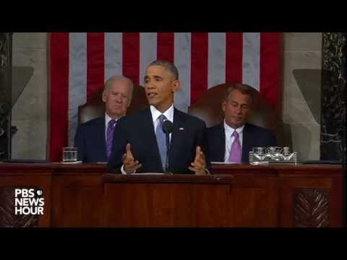
President Obama

Slide 3
Main Points
“Lower the Cost of Community College to $0”
“Have to earn it”
“Keep your grades up”
“Graduate on-time”
“Two years of college is as free and universal as high school is today”

Slide 4
“College Promise” Bill Introduced
Introduced in House and Senate
$80 billion over ten years
$10 billion grant added, aimed at Minority Serving Institutions and Historically Black Colleges and Universities

Slide 5
The Nuts and Bolts
Federal government covers 75% of average cost of community college.
State picks up other 25%
Family AGI > $200,000 do not qualify
Reforms required include
Federal grant award to states that agree to waive community college resident tuition and fees
Providing more advising
Provide more student support
Better aligning high school and college curriculum to reduce remedial education

Slide 6
The Nuts and Bolts (continued)
Community colleges would be required to “adopt promising and evidence-based institutional reforms to improve student outcomes.”
Students must maintain a minimum 2.5 GPA
Students must attend at least ½ time
Eliminates tuition and fees for up to three years

Slide 7
The Nuts and Bolts (continued)
First time students only
States must provide a narrative plan on better aligning post-secondary education within the state
States must provide an explanation of how the state will promote the improved performance of public institutions of higher education through funding reform
Provision aimed at preventing state disinvestment

Slide 8
Historical Context
The Truman Commission proposed a free K-14 model in 1947
In the late 90s ACCT created a list of recommendations

Slide 9
Pros and Cons

Slide 10
Pro
Con
Importance of education, community colleges specifically, to the forefront of conversation
Nothing is free. Free means no value
“I hear you are going to work for free”

Slide 11
Pro
Con
This would reduce student loan debt
First dollar, so Pell still in play.
2.5 GPA requirement, current is 2.0 for financial aid
What if they don’t finish?

Slide 12
Pro
Cons
More students would go to community colleges
New unfunded mandates
More students does not equal financial stability

Slide 13
Pro
Cons
Federal government picks up the majority, states only provide 25%
This is more than many states pay now
More federal accountability
No college student left behind?

Slide 14
Pro
Cons
Oregon and Washington already provide models
States required to allocate a “significant” portion of funding based on performance.

Slide 15
Pro
Cons
“let’s stay ahead of the curve”
We are already behind, many countries provide free college education

Slide 16
Pro
Cons
Under the proposal, the federal government would cover 75 percent of the average cost of community college.
Average cost = $3,800 per year
$126.67 per credit hour (30 credits per year)

Slide 17
Additional Issues
Not all programs qualify
Credits have to be transferrable
Occupational programs must have “high completion rates”
Occupational programs must lead to a degree or certificate in a “high demand field”

Slide 18
Where we are today
Community college presidents starting to work on proposal
AACC and ACCT have been working the issue for years.

Slide 19
ACCT & AACC Recommendations
Reliable financing for planning and enticing state partners
Program eligibility/participation must be stable to allow students to plan
Program must be “first dollar” allowing other forms of financial aid
Clear standards for program eligibility is essential. Accurate measurements of community college performance must be included in Higher Education Act

Slide 20
Recommendations (continued)
Funding must be able to be used for student support
States must be required to maintain current levels of funding for institutions and student financial aid
Current standards of satisfactory academic progress should be used (2.0 GPA)

Slide 21
Questions

